Slide 1
Public Transportation Usage and COVID-19 Infection Rates
ChE 2410 Project 1 – Madison Butler

Slide 2

Motivation
A positive relationship might encourage awareness of hygiene in public shared spaces
A negative relationship or a lack of relationship might help reduce unnecessary avoidance of public transpotation

Slide 3
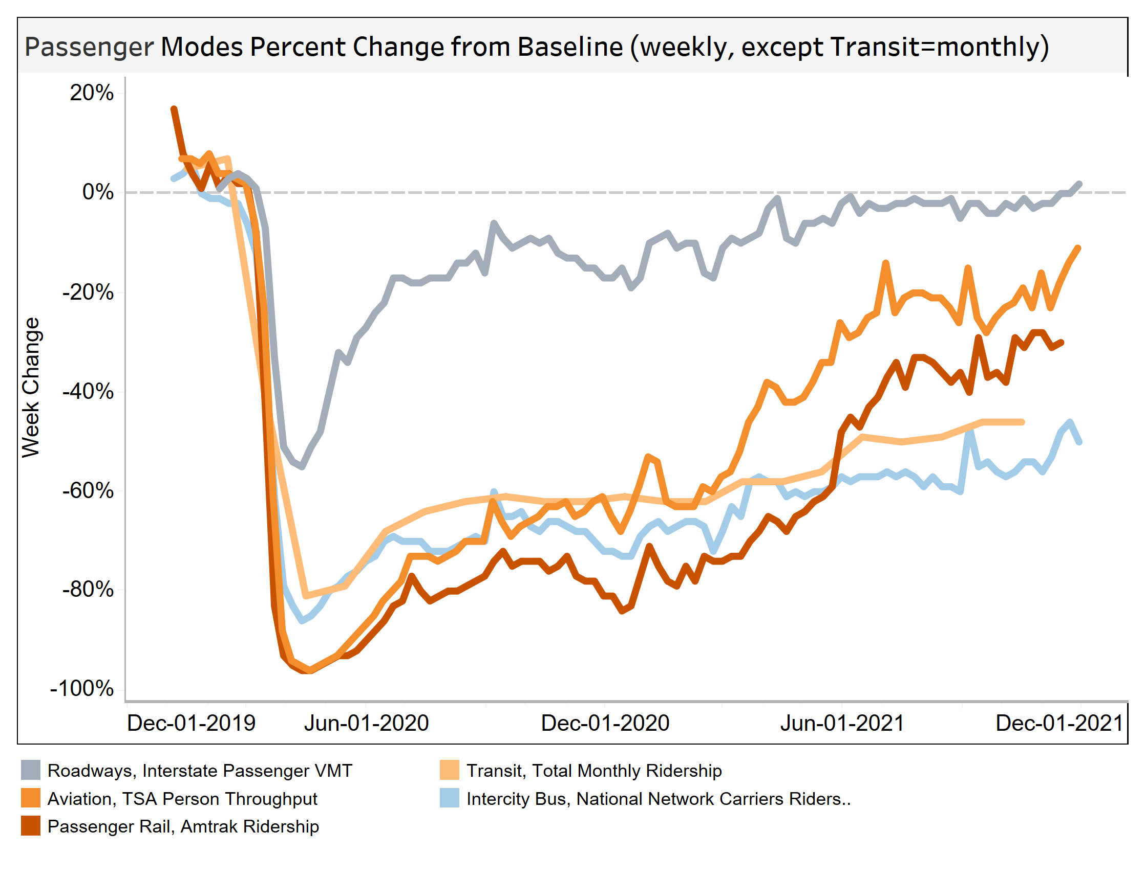
Previous relevant work
[3]
American public transportation workers are at higher risk of death by COVID compared to all industries (2021) ^{[1]}
Increased weekly bus and train usage correlated with increased infection rates^{[2]}
Notes:
We know transit workers are at a higher risk of death from covid compared to all other industries. This means long exposure to these conditions could increase chances of infections, although there are a couple other factors that could influence that relationship, like co-morbidities in the transit worker population.
We know early COVID (jan-march) infections were correlated with transit use generally. This had a couple outliers (NY) that may have influenced the data, but may also be representative of it.
We know weekly increased bus and train usage correlated with higher infection rates.
[1] Heinzerling A, Vergara XP, Gebreegziabher E, et al. COVID-19 Outbreaks and Mortality Among Public Transportation Workers — California, January 2020–May 2022. MMWR Morb Mortal Wkly Rep 2022;71:1052–1056. DOI: http://dx.doi.org/10.15585/mmwr.mm7133a4.
[2] Michael M. Thomas, Neda Mohammadi, John E. Taylor,
Investigating the association between mass transit adoption and COVID-19 infections in US metropolitan areas,
Science of The Total Environment,
Volume 811,
2022,
152284,
ISSN 0048-9697,
https://doi.org/10.1016/j.scitotenv.2021.152284.
[3] https://www.bts.gov/covid-19/week-in-transportation

Slide 4
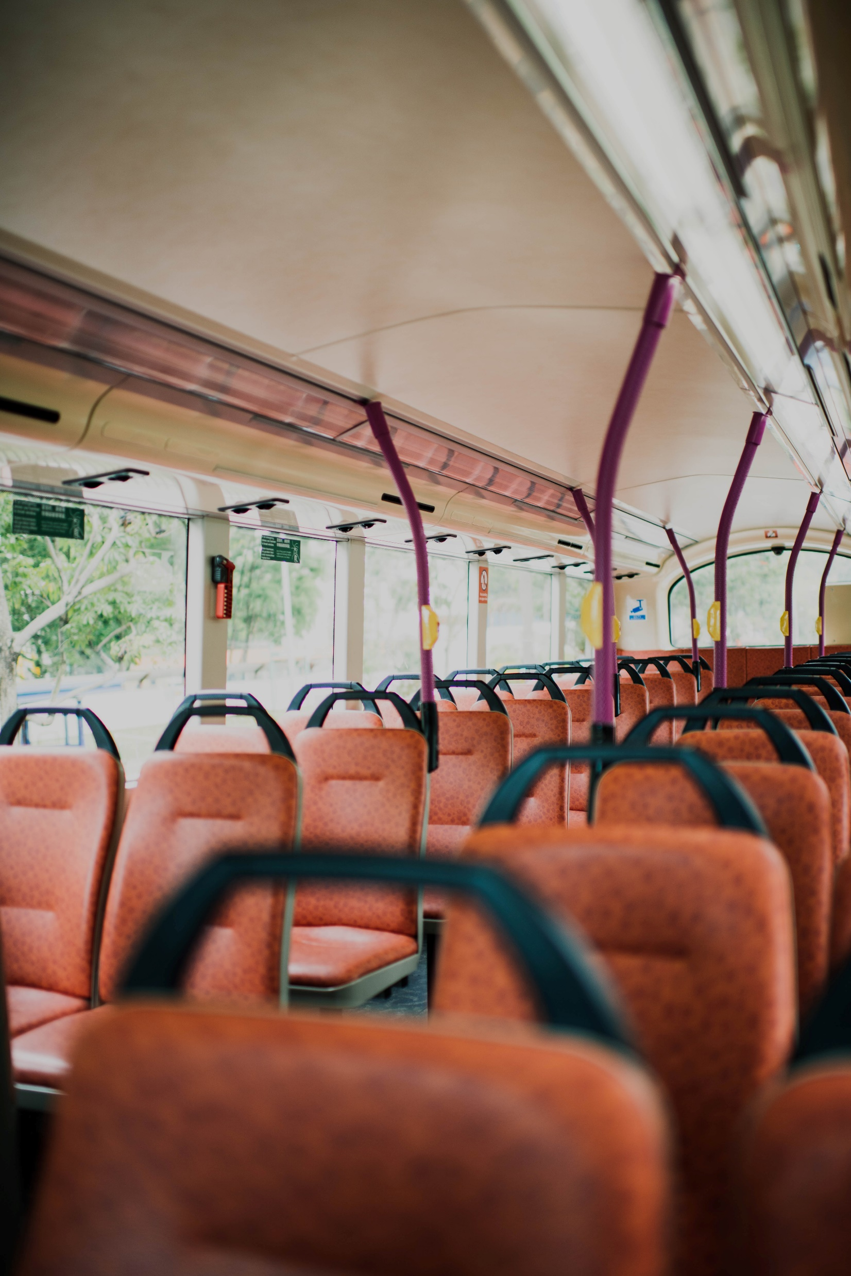
Data sources
COVID cases county level data from NYT 2021
Census.gov information on county level rates of:
Public transportation usage
“Percent of resident workers who commute by transit”
Population density
Population

Slide 5
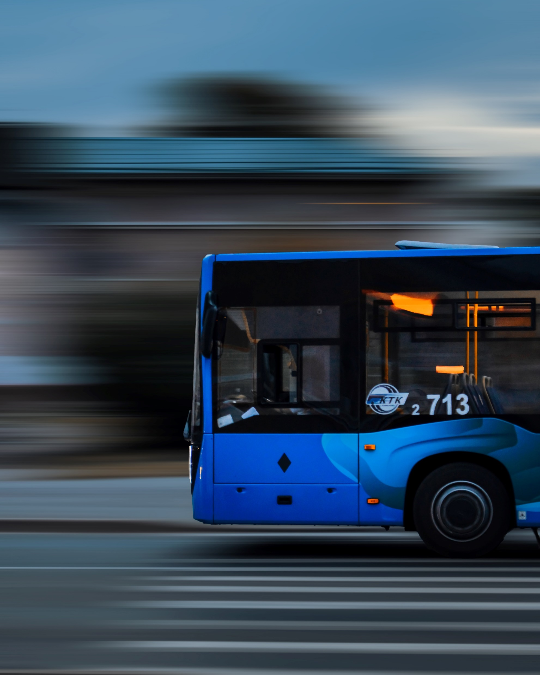
Assumptions
Non-working transit trips are uniform per capita across counties
COVID transit avoidance was uniform per capita across counties
Sum of cases across 2021, a continuous year of COVID, should show a holistic assessment of a county’s ability to fight infection

Slide 6
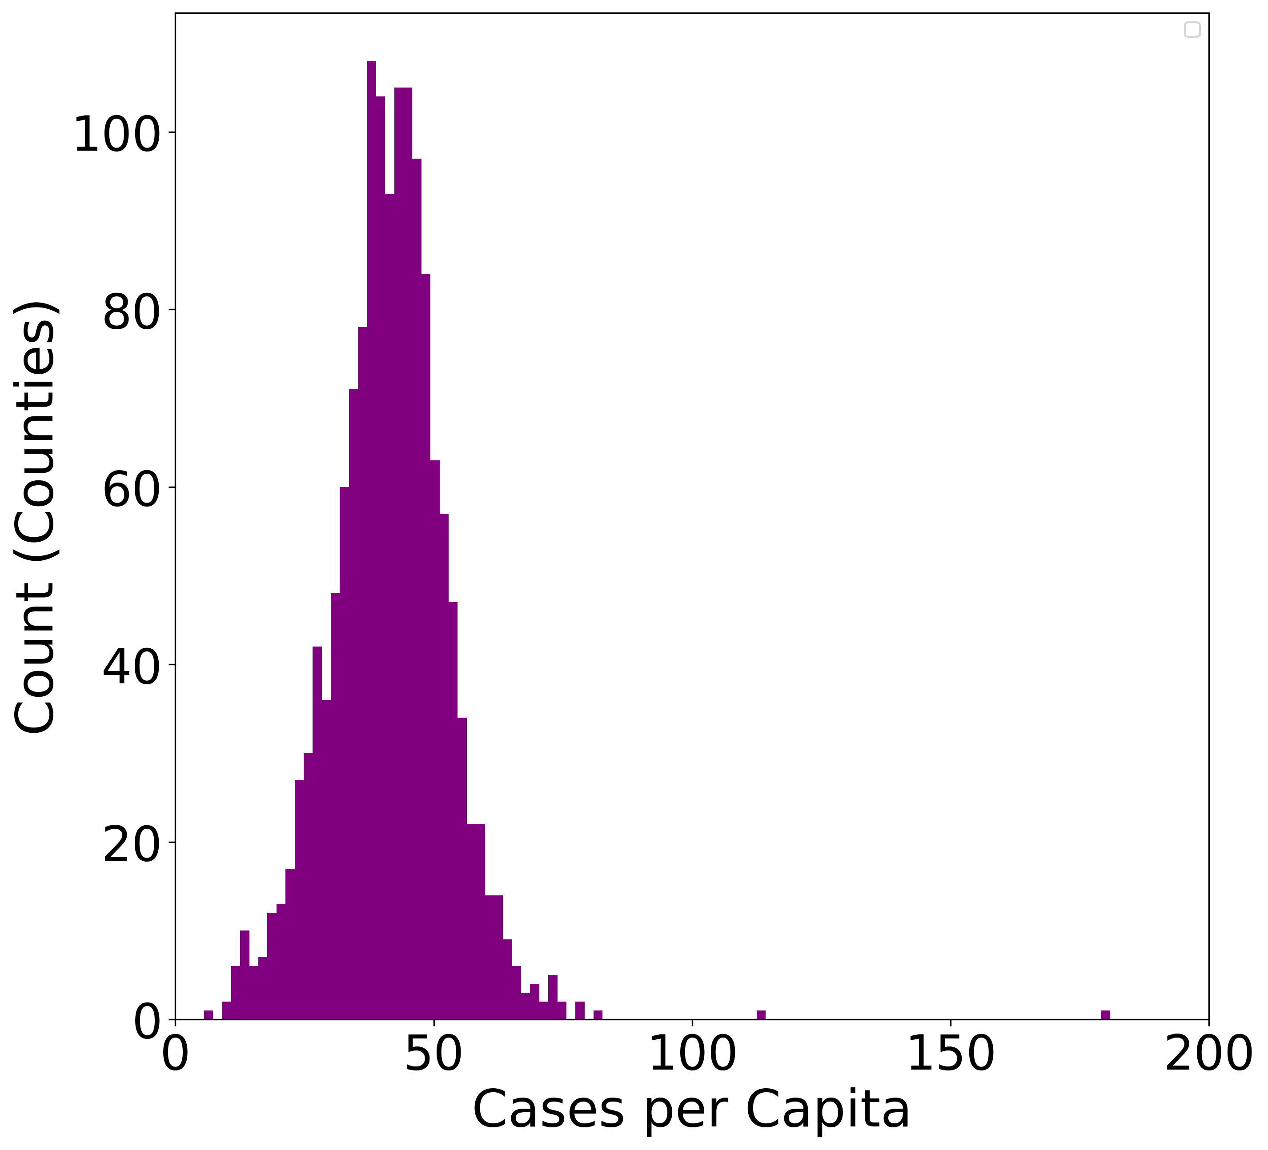
Data overview
Cases per capita data appears normally distributed with distant outliers removed
Asymmetrical outliers: there were high-case counties, but the opposite direction is impossible
μ = 41.5 σ = 11.6 CV = 0.279

Slide 7
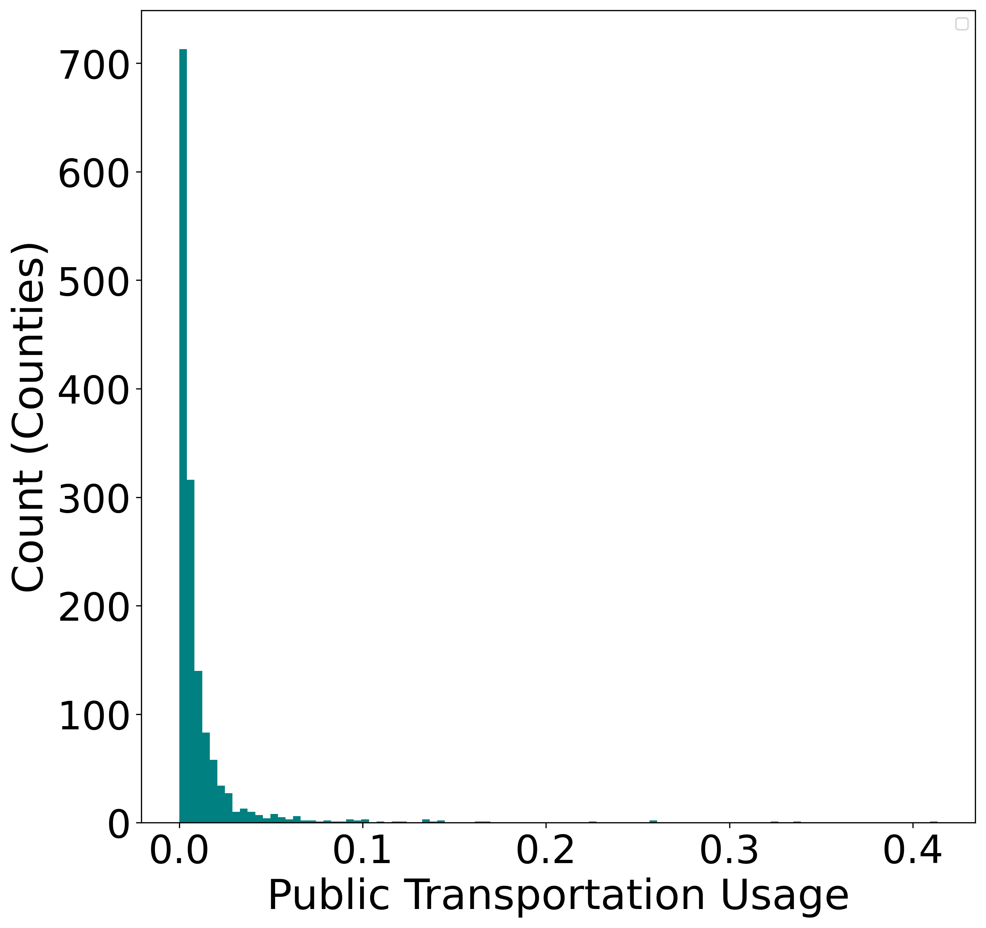
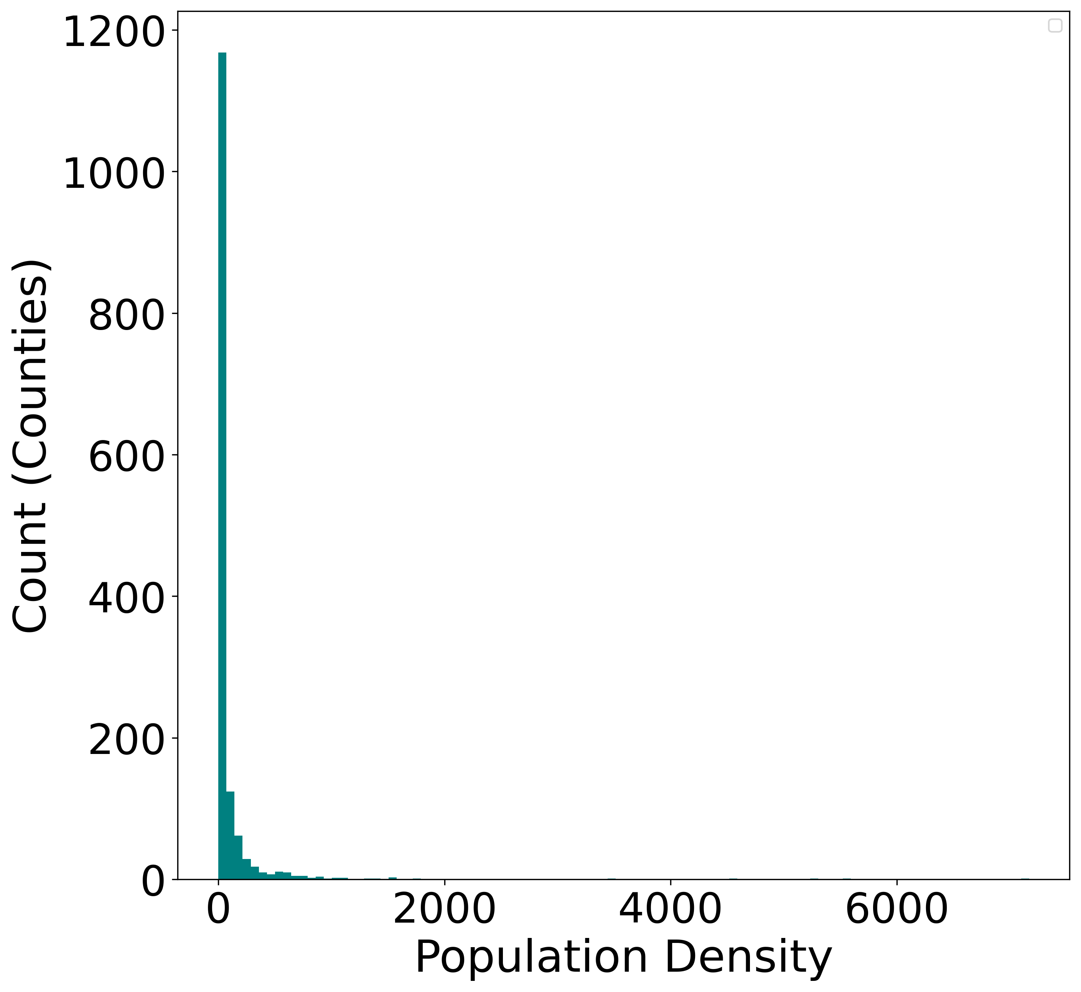
Data overview

Slide 8
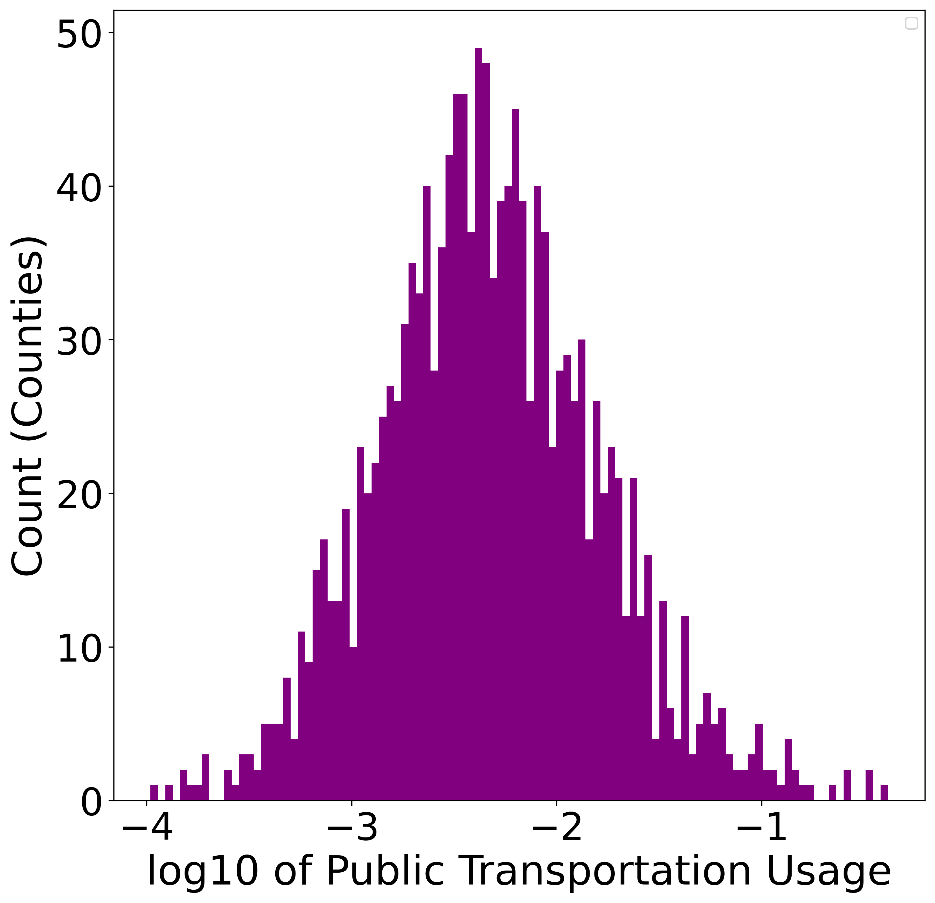
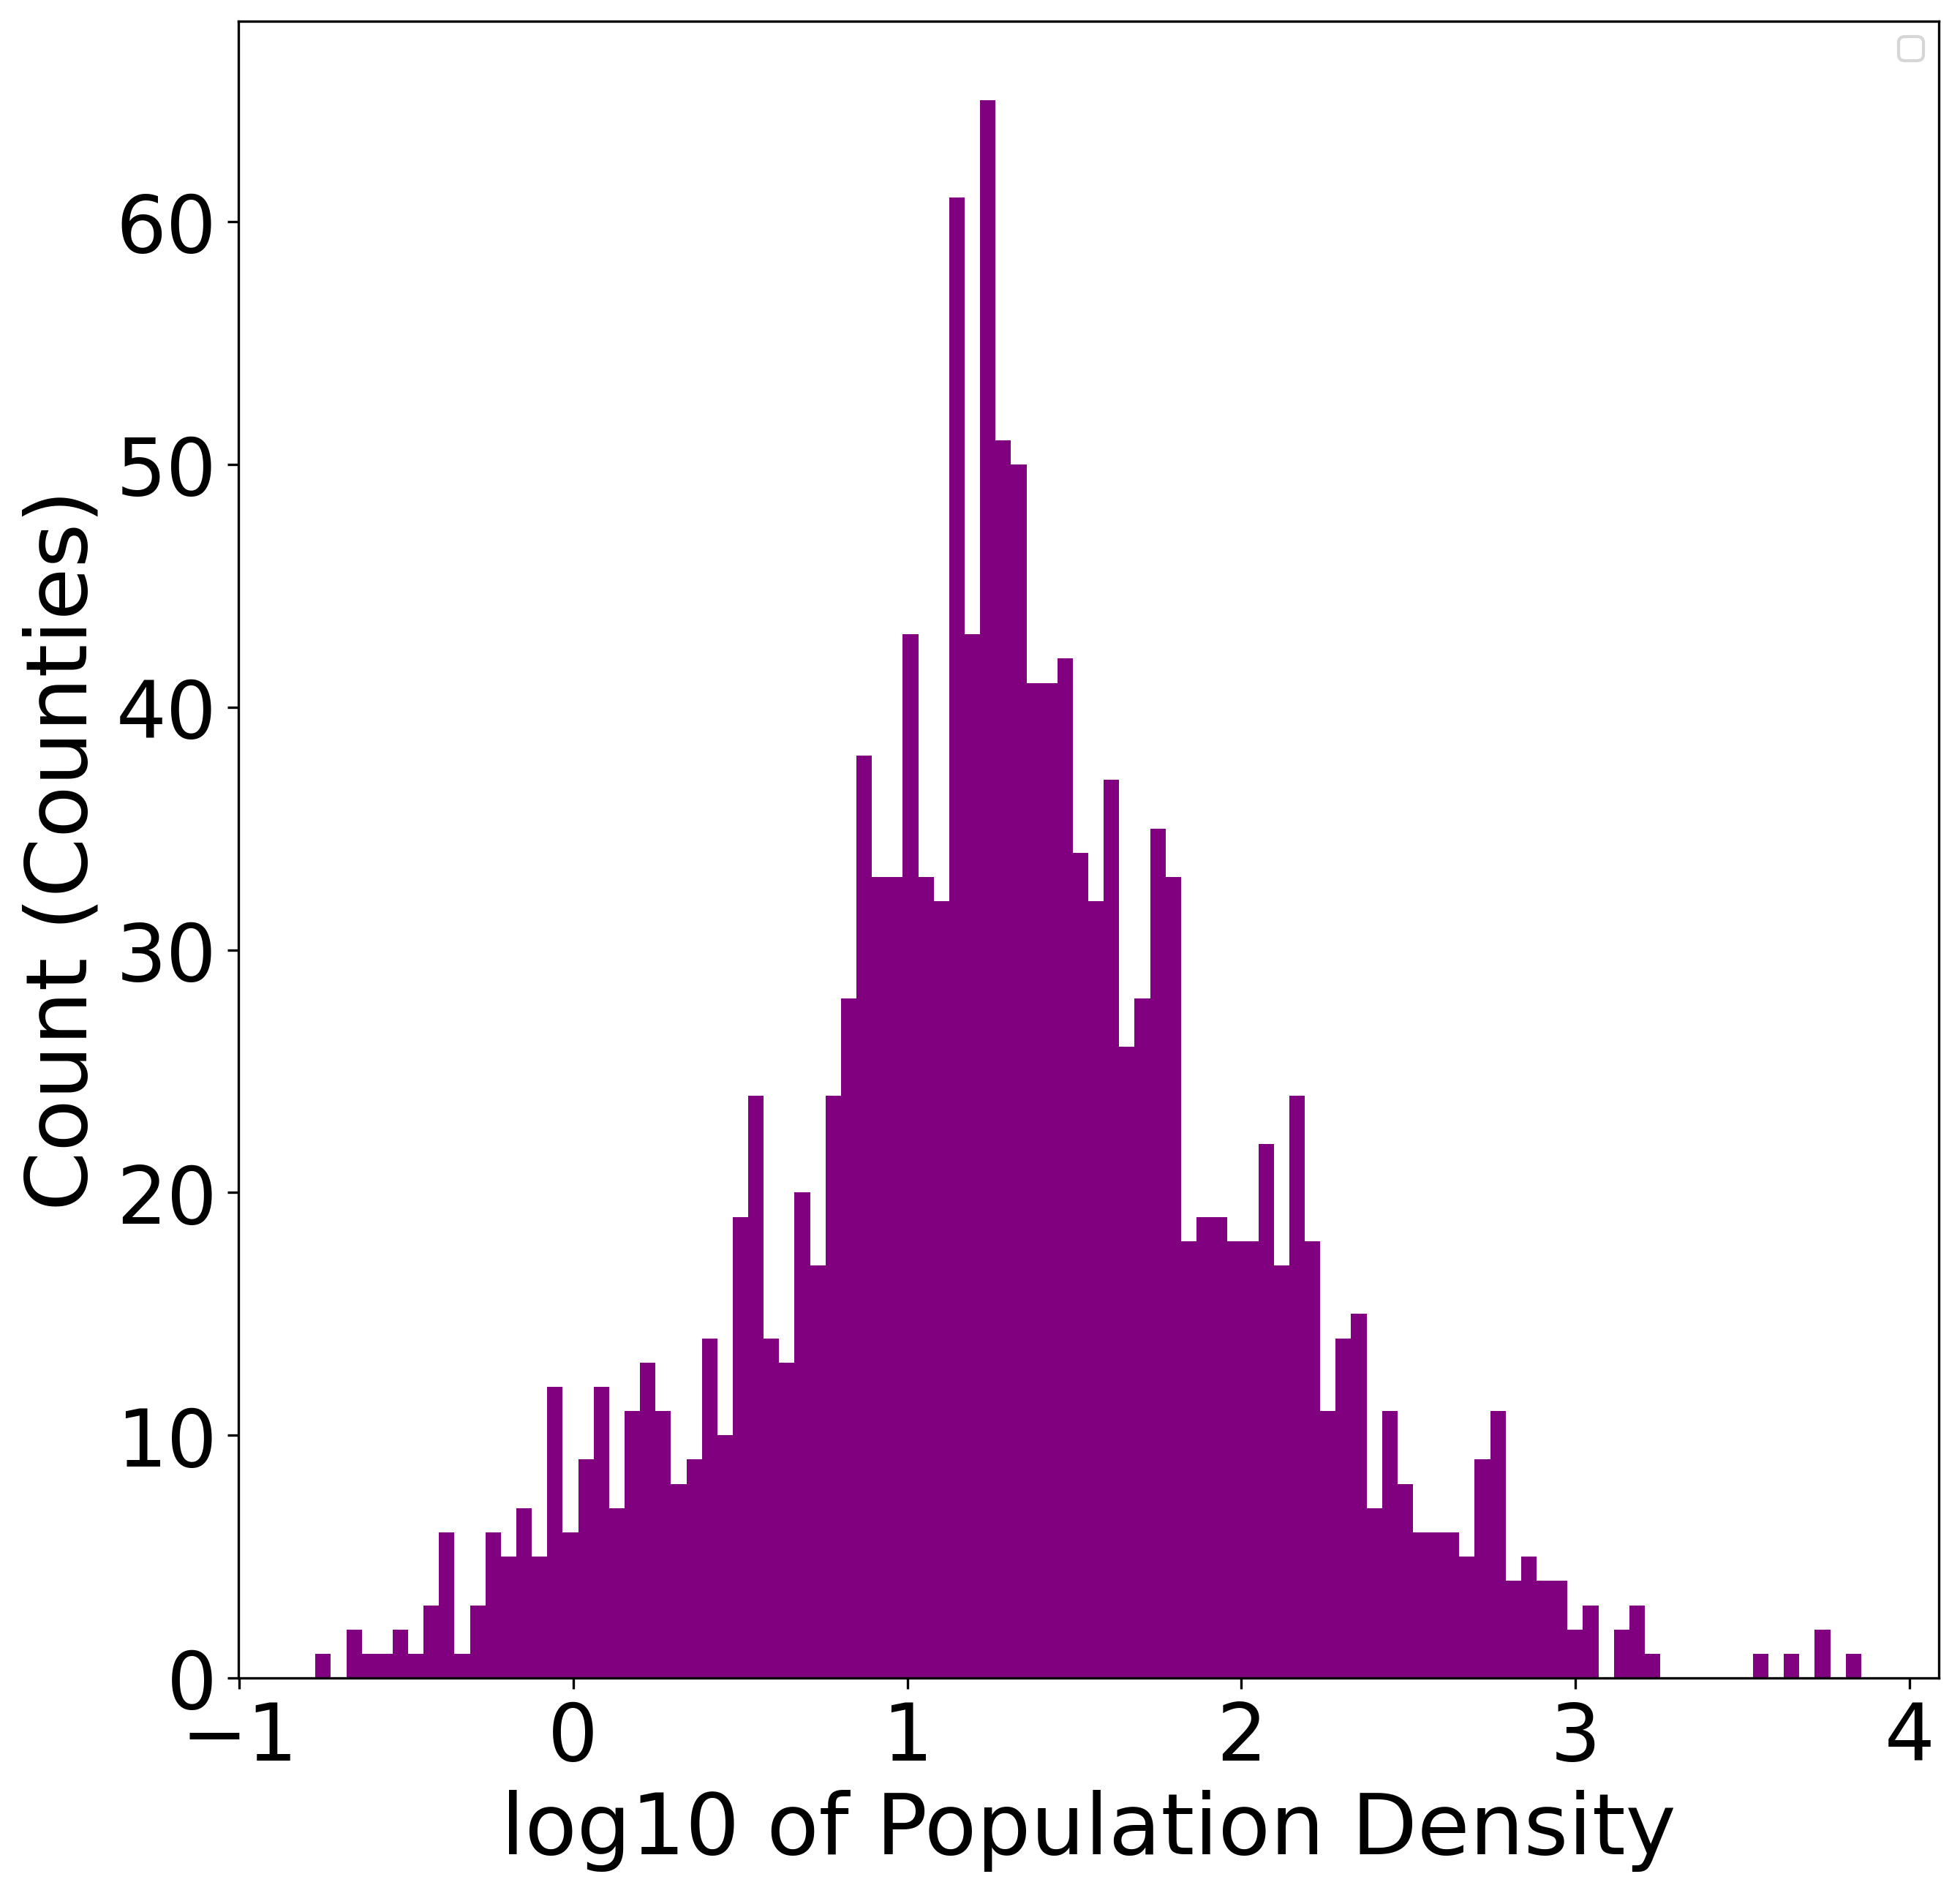
Data overview
μ = -2.33 σ = 0.536 CV = 0.230
μ = 1.32 σ = 0.710 CV = 0.540

Slide 9
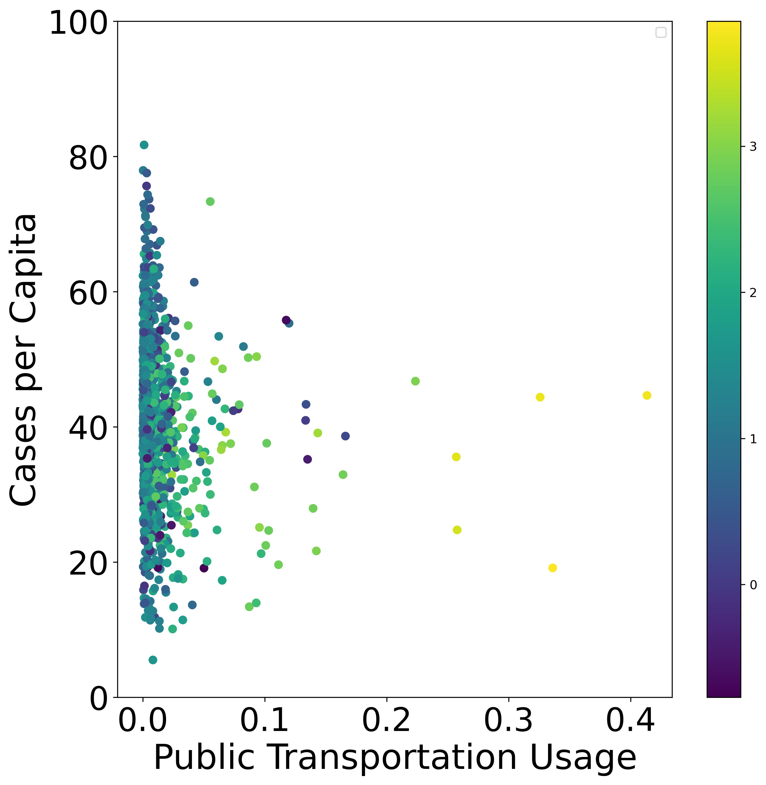
Data overview
Public transportation usage and cases per capita
Population density mapped to color

Slide 10
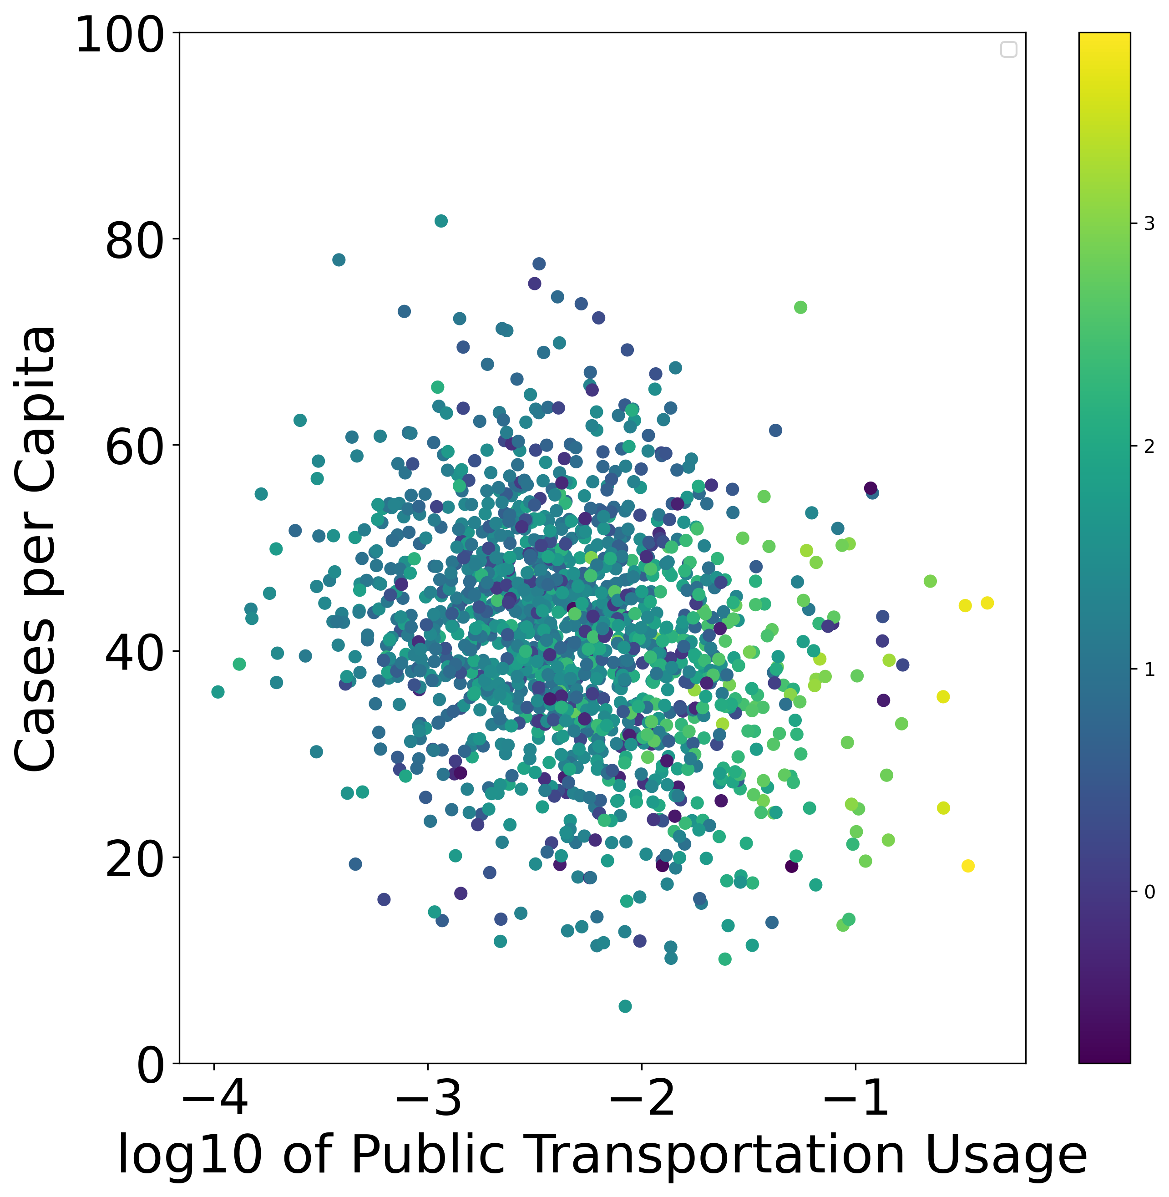
Data overview
Log 10 of public transportation usage
Population density mapped to color

Slide 11
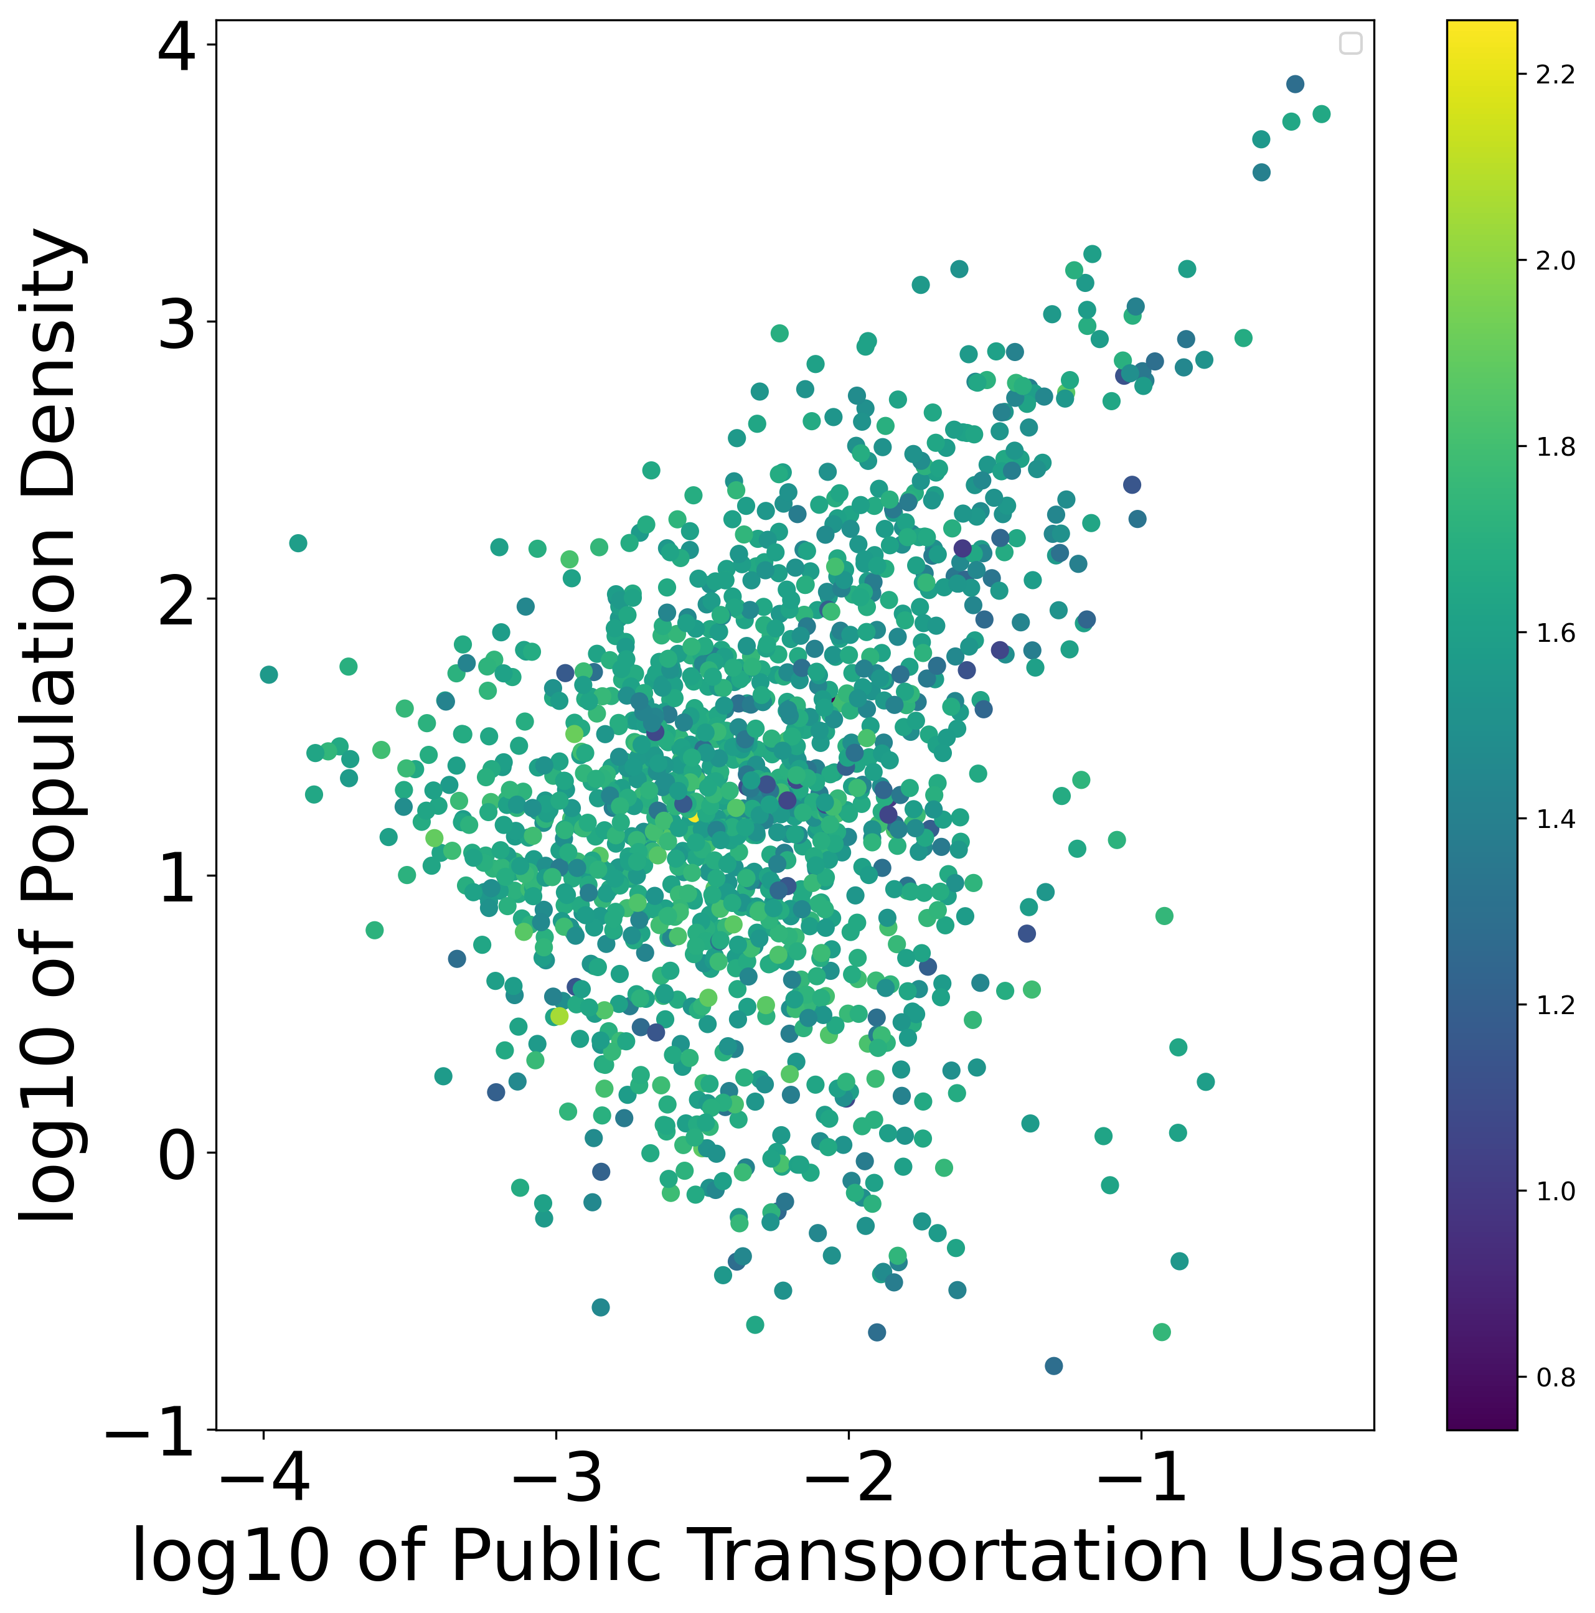
Data overview
Public transportation usage and population density may share relationship
Per capita cases in color

Slide 12
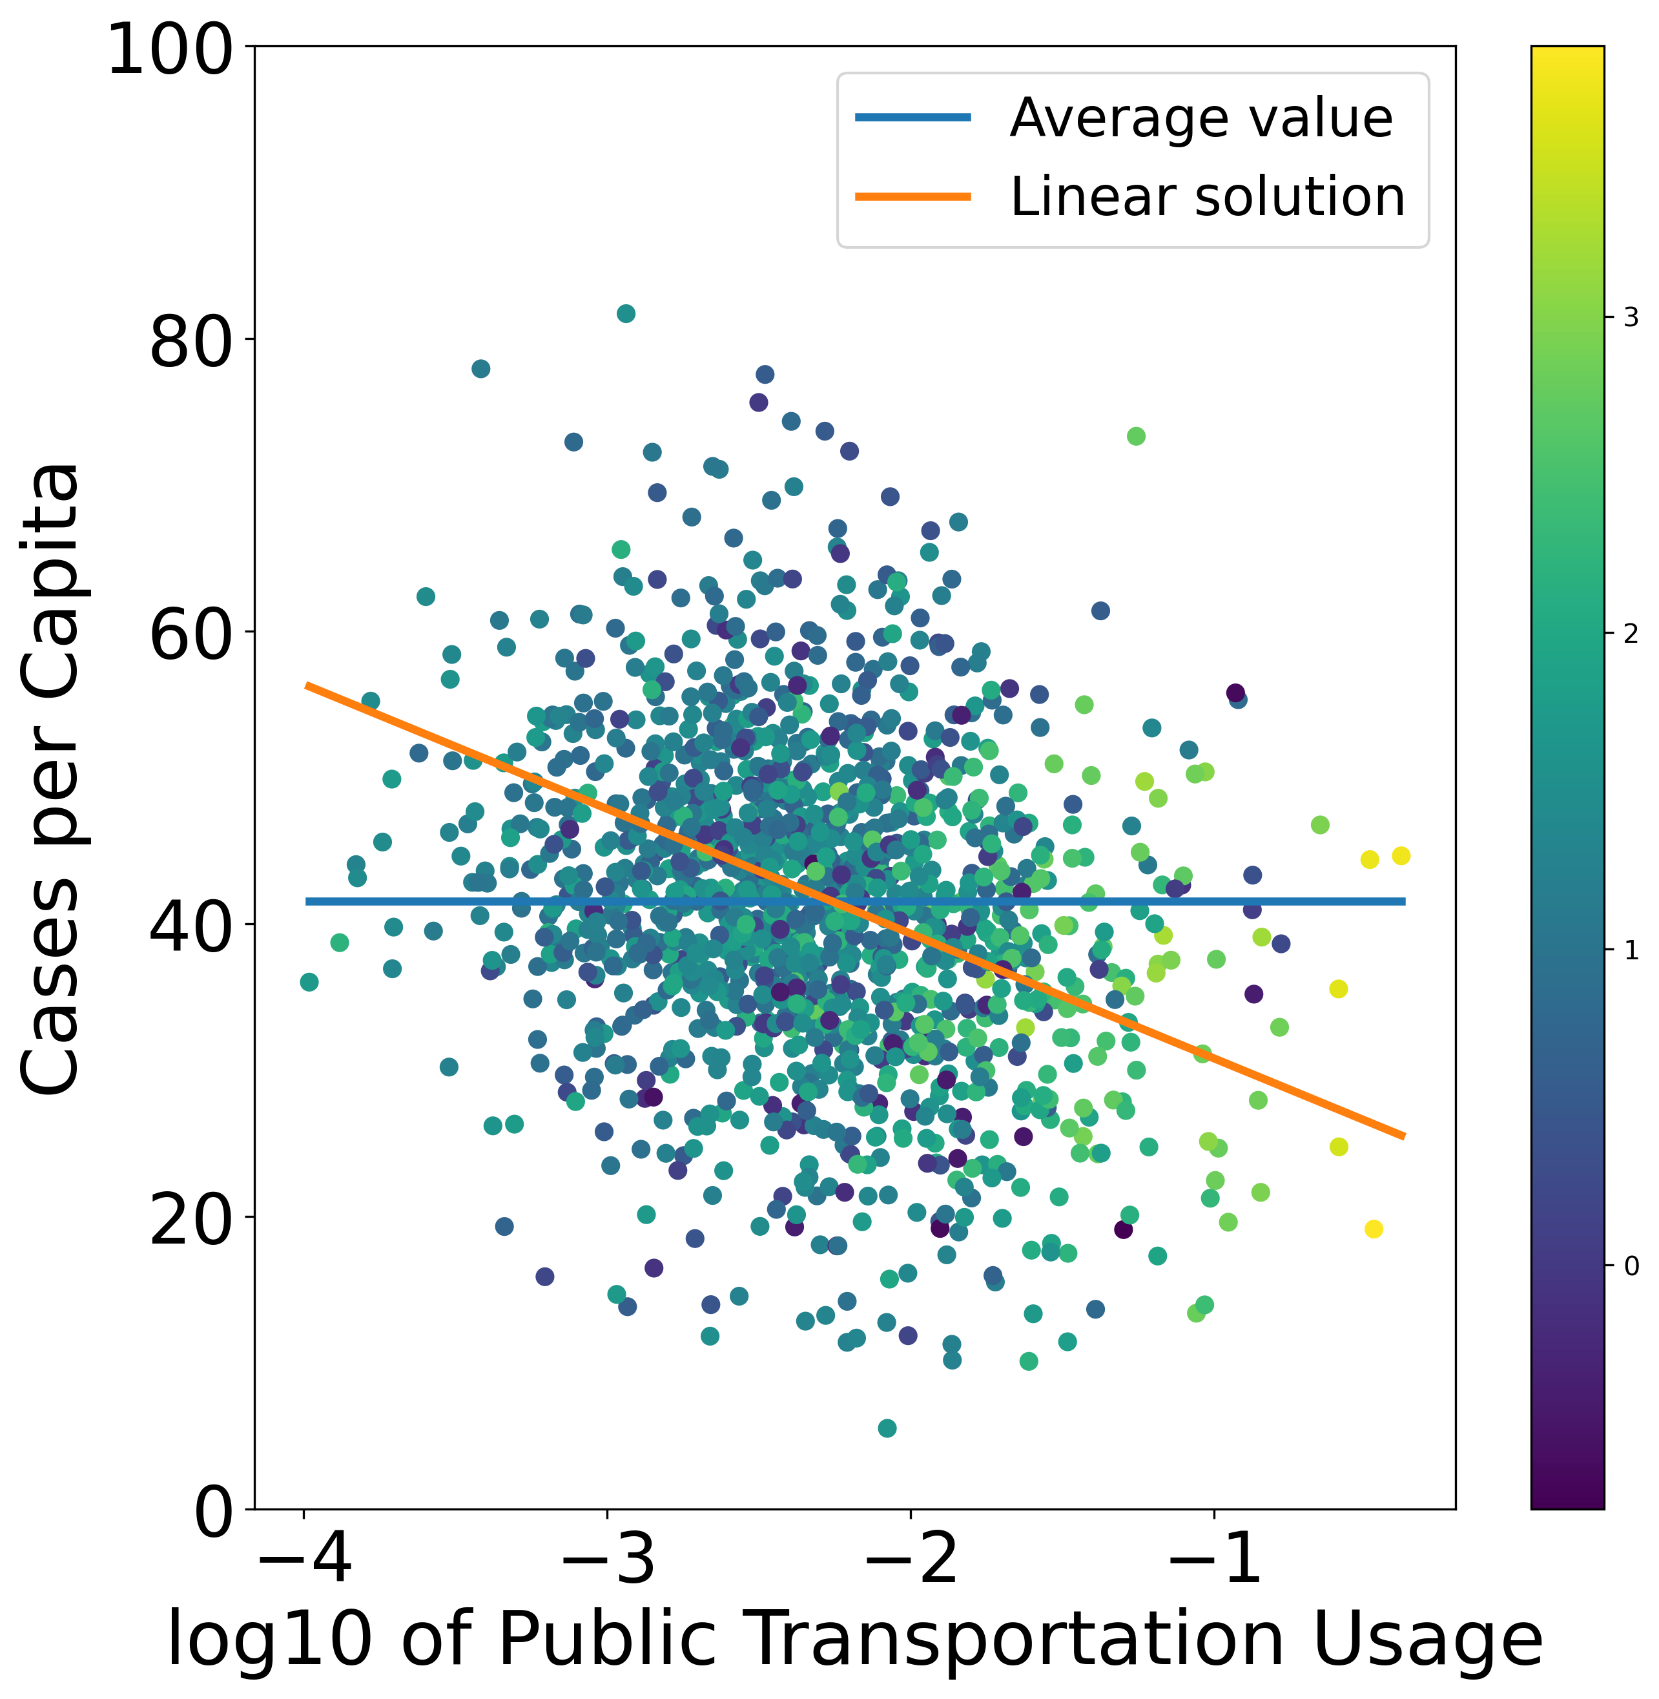
Data analysis
$$y=a∗x_{1}+b∗x_{2}+c∗x_{1}∗x_{2}+d$$
Where:
x₁ = log10(transportation usage)
x₂ = log10(population density)
y = cases
Model | SSE
Average | 1.9812 E15
Linear | 1.8798 E15
Notes:
R^2 = (SST-SSE)/SST

Slide 13
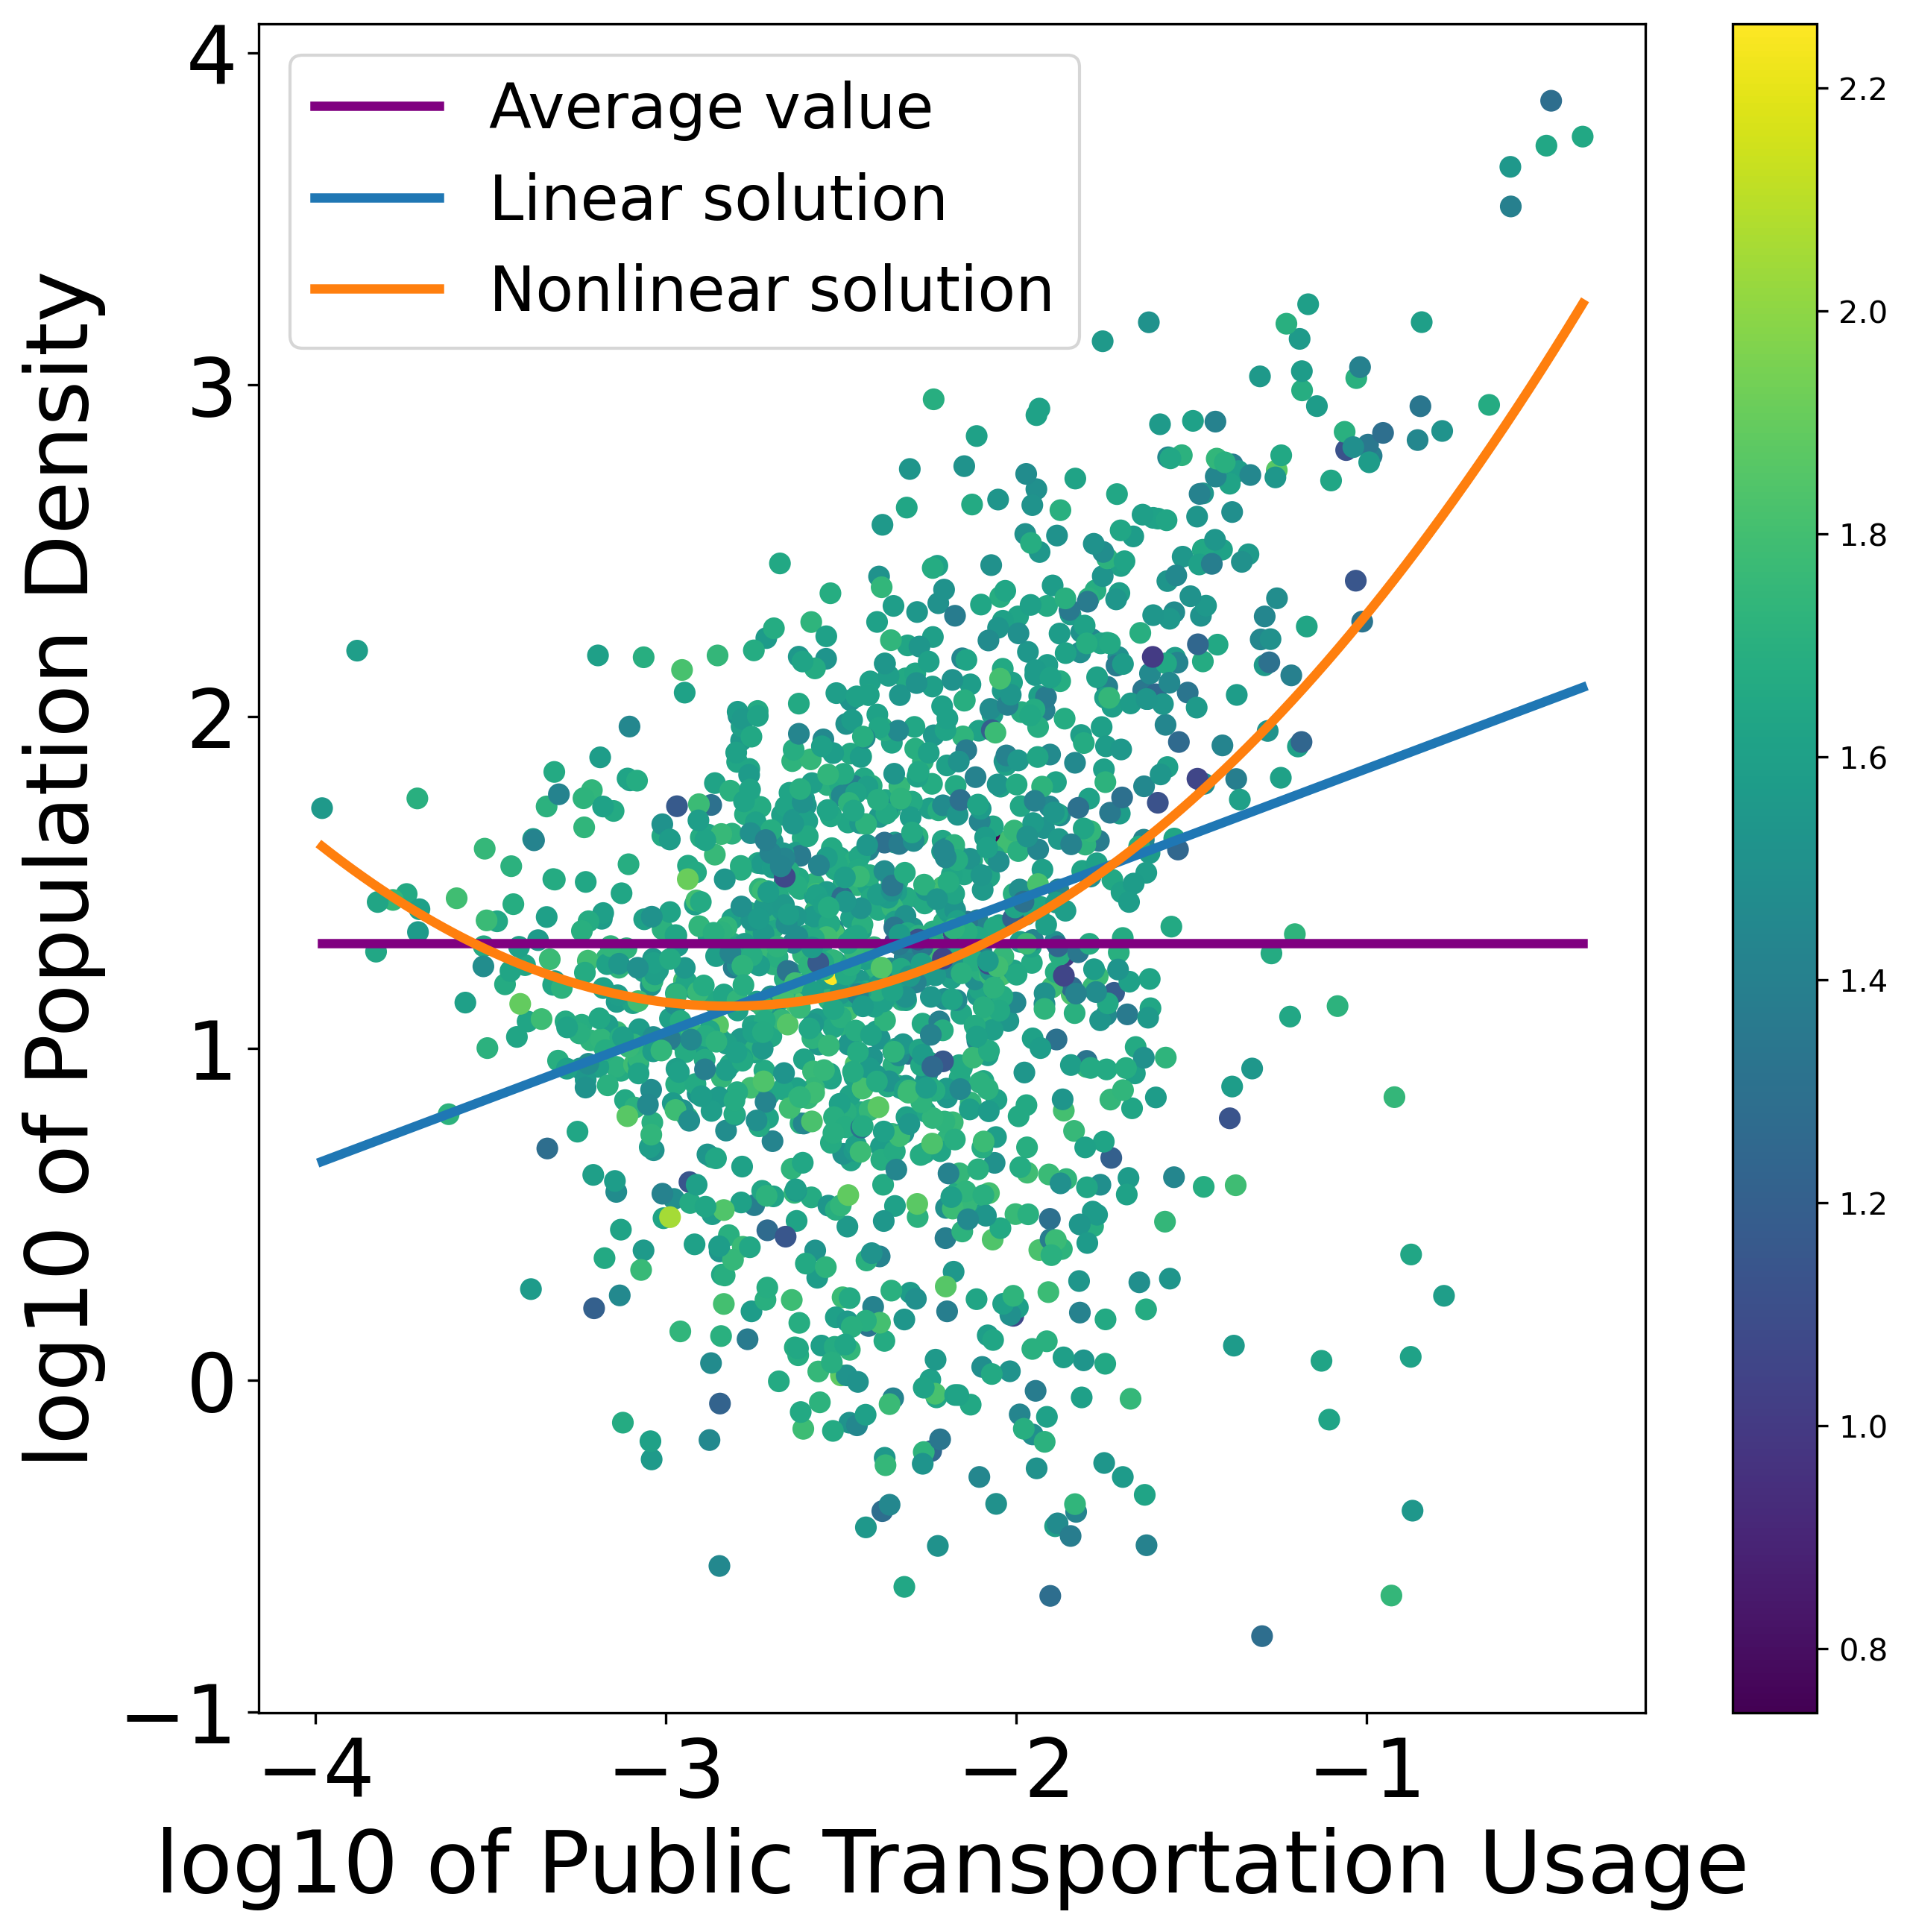
Data analysis
$$y=a∗x_{1}+b$$
$$y=a∗{x_{1}}^{2}+b∗x_{1}+c$$
Where:
x₁ = log₁₀(transportation usage)
y = cases
Model | SSE
Average | 743
Linear | 676
Nonlinear | 641
Notes:
R^2 = (SST-SSE)/SST

Slide 14

Summary of findings
No significant relationship between public transportation usage and COVID cases per capita, including when controlling for population density and interactions
Relationship identified between population density and public transportation usage

Slide 15
Limitations
All county data may have obscured relationship by including too many counties without much public transportation usage
America does not have a lot of counties with robust public transportation and was bad at stopping infections

Slide 16
Next Steps
Pick case studies of metro areas with high public transportation – how did those counties do with cases over time
Try country level data, controlling for PPE use
Find better source for total cases
Maybe use relationship between population density and transit use to create a new model for prediction

Slide 17
Sources
[1] Heinzerling A, Vergara XP, Gebreegziabher E, et al. COVID-19 Outbreaks and Mortality Among Public Transportation Workers — California, January 2020–May 2022. MMWR Morb Mortal Wkly Rep 2022;71:1052–1056. DOI: http://dx.doi.org/10.15585/mmwr.mm7133a4.
[2] Michael M. Thomas, Neda Mohammadi, John E. Taylor,Investigating the association between mass transit adoption and COVID-19 infections in US metropolitan areas, Science of The Total Environment, Volume 811, 2022, 152284, ISSN 0048-9697, https://doi.org/10.1016/j.scitotenv.2021.152284.
[3] https://www.bts.gov/covid-19/week-in-transportation
Images from unsplashed

